Slide 1
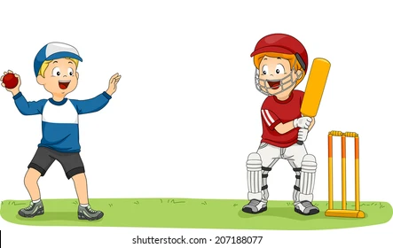
PE Clubs
June – July Half Term
All clubs will run from 3pm – 4pm approximately due to PE teachers teaching until then.
Athletics Club – Until 21st June (CFO/RST/LSU)
Mondays
&
Thursday
All year groups welcome
On the school fields
Cricket Club (CJA) Monday
Year 7 & 8
Thursday
Yr 9 & 10
Rounders (VWA)
Tuesday
All year groups welcome
Leadership Academy (CJA)
(Yr 9) - Friday
Cheer Leading Club – Thursday Yr 7&8
Please bring your PE kit and change at the end of the school day if you are going to take part in a club!
Talent Development
(Yr 7-9) – Friday with Mr Staples

